Slide 1

Design & Verification of an ALU using UVM & SVA
Abdelrahman Mohamed Yassien dir: /home/svgpdv25abohamad/alu_uvm_project

Slide 2
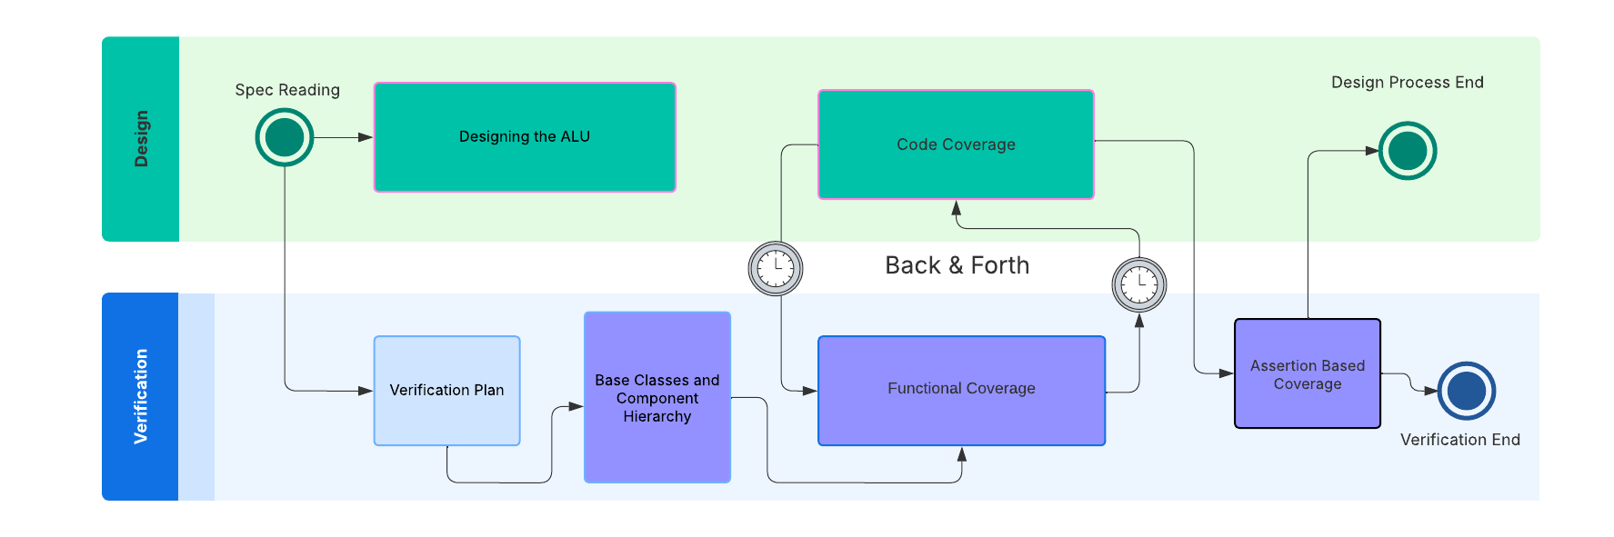
Project Timeline

Slide 3
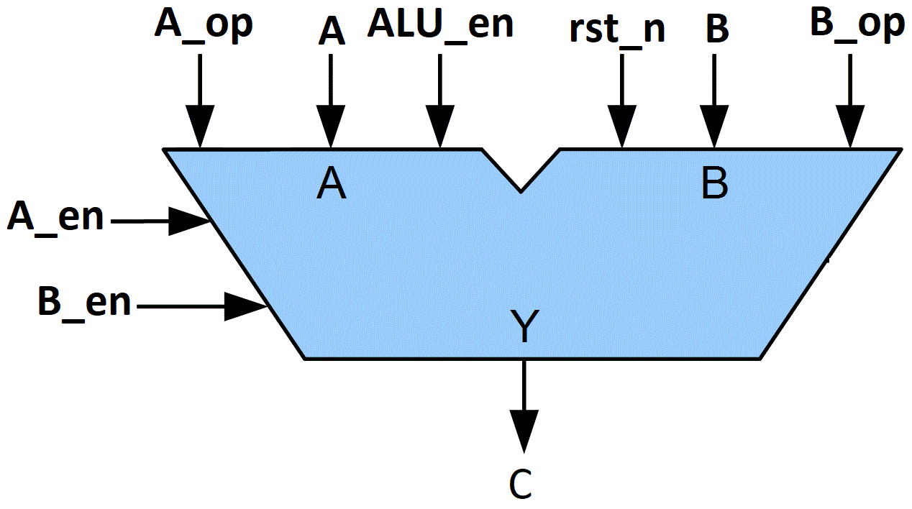
ALU DESIGN SPECIFICATIONS
(A_EN & ~B_EN) | A_op | C = ? | Description
 | 0 | A + B | Sum of inputs
 | 1 | A – B | B subtracted from A
 | 2 | A ^ B | A bitwise XOR B
 | 3 | A & B | A bitwise & B
 | 4 | A & B | A bitwise & B
 | 5 | A | B | A bitwise OR B
 | 6 | ~(A ^ B) | A XNOR B
 | 7 | NULL | Not permitted to take this value
(A_EN & B_EN) | B_op | C= ? | Description
 | 0 | A + B | Sum of inputs
 | 1 | A – B | B subtracted from A
 | 2 | A ^ B | A bitwise XOR B
 | 3 | A & B | A bitwise & B
(~A_EN & B_EN) | B_op | C = ? | Description
 | 0 | ~(A & B) | A NAND B
 | 1 | A + B | Sum of inputs
 | 2 | A + B | Sum of inputs
 | 3 | NULL | Not permitted to take this value

Slide 4
TOP ALU TESTBENCH
RANDOM TEST
ERROR_TEST
REPITITION TEST
ENVIRONMENT
SCOREBOARD
ALU AGENT
RST AGENT
Predictor
Comparator
Sequence
Sequence
Coverage Collector
Virtual Sequence
Sequencer
Sequencer
DRIVER
INPUT MONITOR
OUTPUT MONITOR
MONITOR
DRIVER
Virtual Sequencer
Virtual Interface
Virtual Interface
ALU Interface
RST Interface
DUT

Slide 5
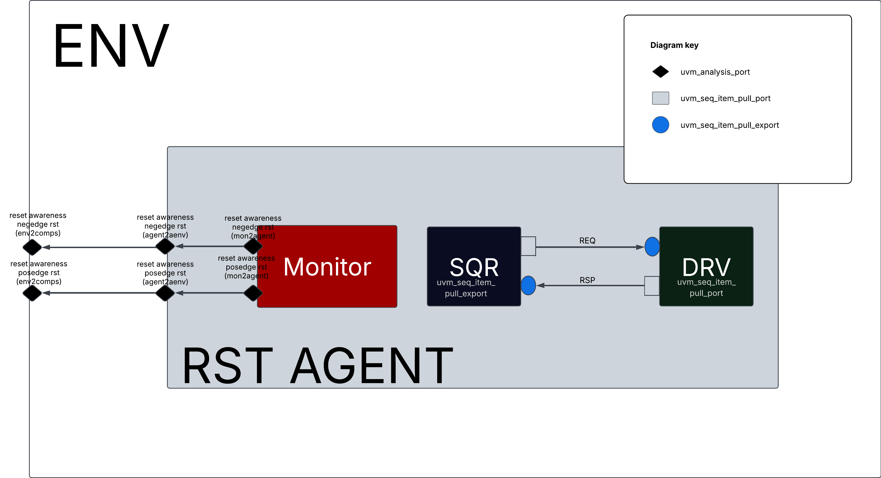
RST AGENT TLM DIAGRAM
The reset awareness was inspired from The published paper Handling Asynchronous Reset(s) Testing by building reset-awareness into UVM testbench components by Wei Wei Cheong, Katherine Garden, Ana Sanz Carretero which was previewed @DVCON 2021
As shown in the figure, the rst agent monitor class is always waiting for reset assertion, and as soon as it is asserted, the monitor class writes to the uvm_tlm_analysis_port so it reaches every reset_aware component and hence allows them to act accordingly.

Slide 6
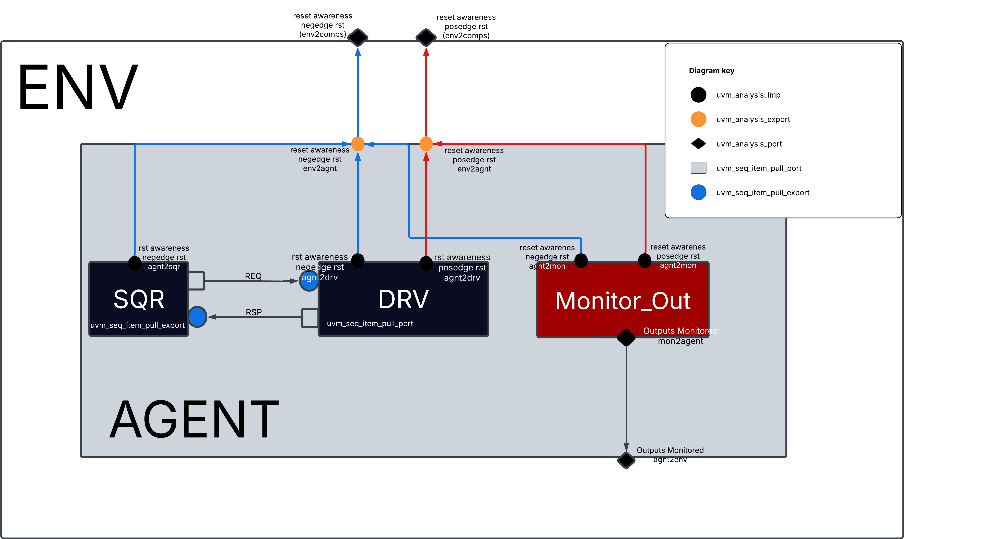
ALU AGENT TLM DIAGRAM
The reset awareness was inspired from The published paper Handling Asynchronous Reset(s) Testing by building reset-awareness into UVM testbench components by Wei Wei Cheong, Katherine Garden, Ana Sanz Carretero which was previewed @DVCON 2021
As shown in the figure, the alu agent is fully reset aware, every component is connected with uvm_tlm_analysis_imp s to allow it to react to asynchronous reset assertion.
Note: the sequencer in this agent the stop_sequences() function is called within the write function body defined @it, therefore stopping all sequences and calling item_done to all the current running items by the driver.

Slide 7
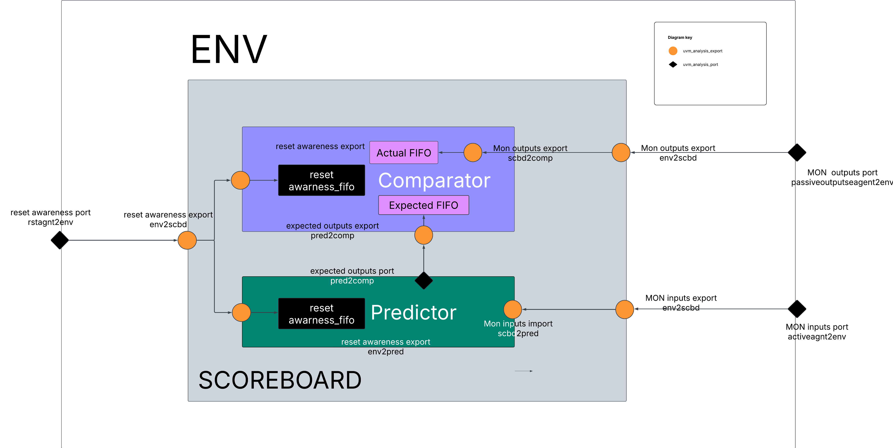
SCOREBOARD TLM DIAGRAM The hierarchy of this scoreboard is inspired from Clifford Cumming’s OVM-UVM Scoreboards-Fundamental Architectures The reset awareness was inspired from The published paper Handling Asynchronous Reset(s) Testing by building reset-awareness into UVM testbench components by Wei Wei Cheong, Katherine Garden, Ana Sanz Carretero which was previewed @DVCON 2021

Slide 8
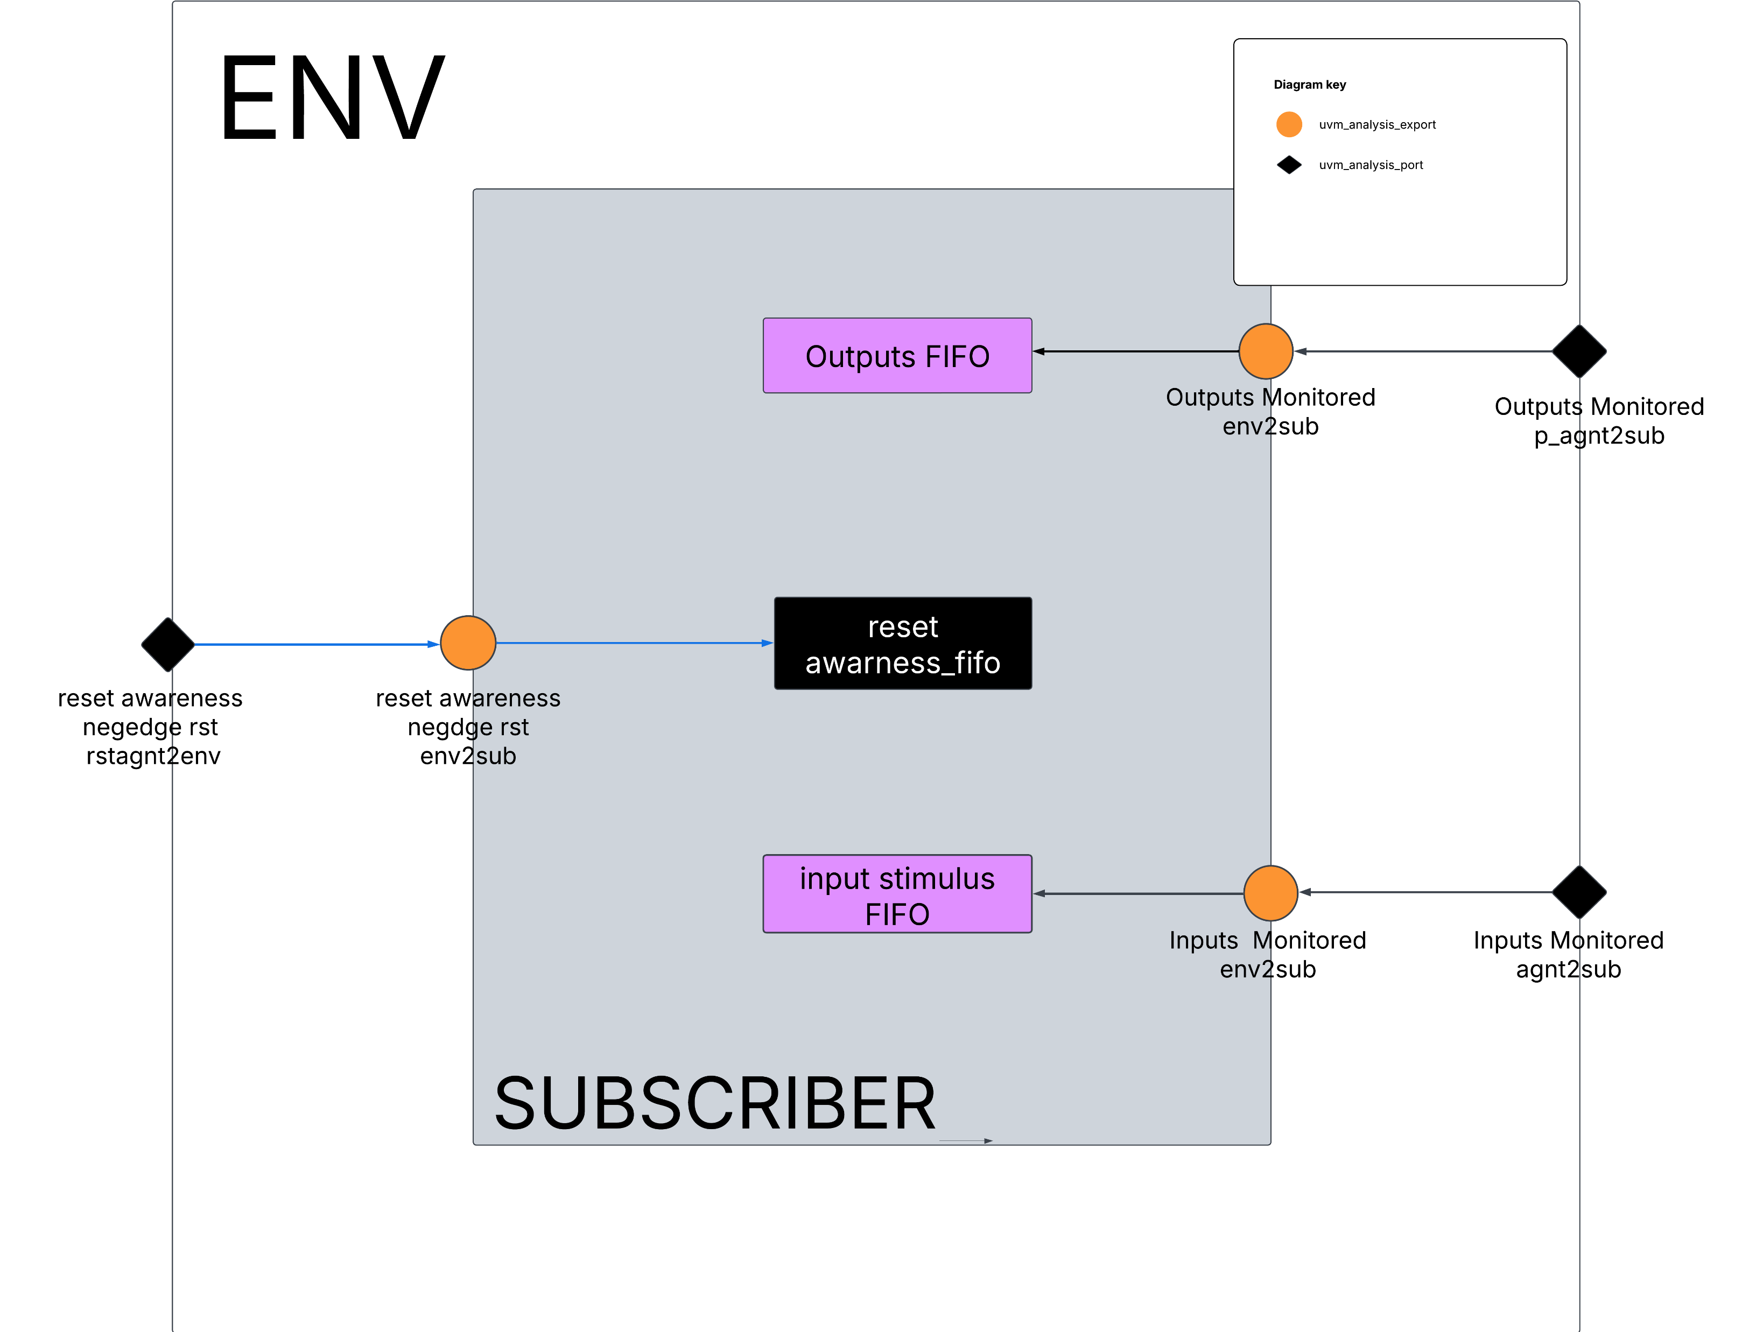
SUBSCRIBER TLM DIAGRAM The reset awareness was inspired from The published paper The reset awareness was inspired from The published paper Handling Asynchronous Reset(s) Testing by building reset-awareness into UVM testbench components by Wei Wei Cheong, Katherine Garden, Ana Sanz Carretero which was previewed @DVCON 2021

Slide 9
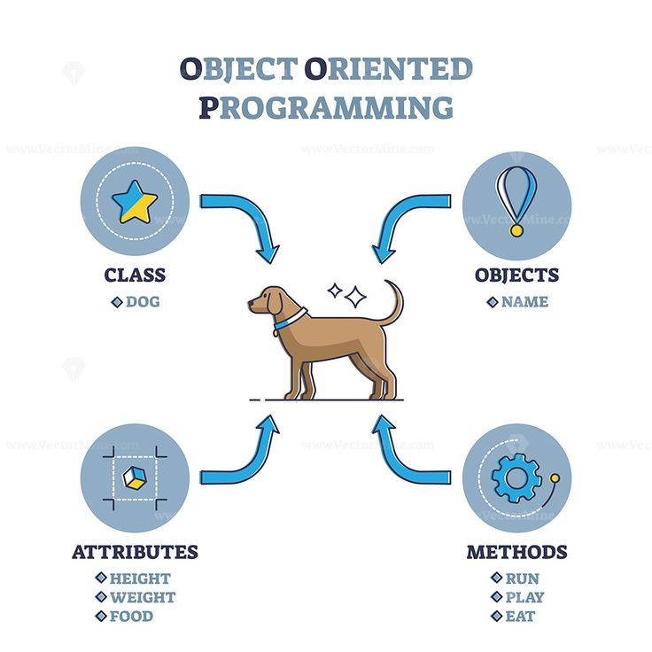
Classes? What do they do?

Slide 10

Configurations

Slide 11
Configurations
Test Config
Initialized through the top_testbench
Sets the number of resets per test
Sets the timeout timer to prevent the tool from hanging
Is used to set the rst_vif & the alu_vif to the env
Sets the test name
Sets the type of the alu agent & the rst agent (active or passive)
Is set to the uvm_top_test through the uvm_config_db
Env Config
Is Initialized in the base_test class using the test_cfg handle
Sets the rst_vif & is used to set the alu_vif to their prespective agents
Sets the type of the alu agent & the rst agent (active or passive)
Is set to the env_h through the uvm_config_db
ALU agent Config
Is Initialized in the env class using the env_cfg handle
Sets the rst_vif & is used to set the alu_vif to ALU MONITOR & ALU DRIVER
Is set to the ALU_agent_h through the uvm_config_db
RST agent Config
Is Initialized in the env class using the env_cfg handle
Sets the rst_vif & is used to set the alu_vif to RST MONITOR & RST DRIVER
Is set to the RST_Agent_h through the uvm_config_db

Slide 12

Sequence Items

Slide 13
ALU Sequence Item
Sequence_Item
Defines the rand input stimulus (EXCEPT FOR THE RST) of the DUT, and also the output in case of using a reactive agent for responses
Registers all the stimulus within the factory to be compared, copied, cloned, printed, packed or unpacked (overriding each function do_X respectively)
Defines the constraints for the design specifications
Defines multipile static flags to control coverage and test termination
Error_sequence_item
Inherits the sequence_item and all of its methods, constraints..etc
Turns off the design specification constraints

Slide 14
RST Sequence Item
RST Sequence Item
Defines RAND RST stimulus of the DUT, and also RST_DURATION, RST_DELAY…and other static variables to control coverage and rsts assertion during the test
Registers all the stimulus within the factory to be compared, copied, cloned, printed, packed or unpacked (overriding each function do_X respectively)
Defines the constraints for the rst stimulus and control variables/signals

Slide 15

Environment & It’s Components

Slide 16
ENVIRONMENT
ENV
Constructs the parent using super.new();
Instantiates all the environment components (Agents, Virtual Sequencer..etc) and Creates them using uvm_factory
Connects the rst_agent tlm to the rest of the environment (Scoreboard, Subscriber, alu_agent). Also uses get_provided_to and get_connected_to to debug TLM connections.
Initializes both rst_agent & alu_agent configs and sets them to their prespective agents

Slide 17

AGENT

Slide 18
ALU ACTIVE AGENT
ALU AGENT
Constructs the parent using super.new();
Receives Configuration from alu_agnt config file
Inestantiates Input_Monitor, Driver & Sequencer
Is fully reset aware

Slide 19
ALU DRIVER
DRIVER
Constructs the parent using super.new();
Translates the transaction level items to pin level ones.
Receives the transactions from the sequences through seq_item_pull_port by the sequencer
Sends the stimulus to the dut & terminates operation if a rst is detected by the rst_agnt

Slide 20
ALU INPUT MONITOR
INPUT MONITOR
Constructs the parent using super.new();
Translates the pin level items to transaction level ones.
Constantly monitors the dut to observe its behavior to driven stimulus
Terminates the monitoring operation if a rst is detected by the rst_agnt

Slide 21
ALU OUTPUT MONITOR
OUTPUT MONITOR
Constructs the parent using super.new();
Translates the pin level items to transaction level ones.
Constantly monitors the dut to observe its behavior to driven stimulus
Terminates the monitoring operation if a rst is detected by the rst_agnt

Slide 22
ALU SEQUENCER
SEQUENCER
Constructs the parent using super.new();
Transmits sequence_items from alu sequences to alu_driver
Is connected to the alu_driver in the alu_agent using seq_item_pull_export
Calls Stop_sequences(); if a rst assertion is written by the rst_agent

Slide 23
RST ACTIVE AGENT
RST AGENT
Constructs the parent using super.new();
Receives Configuration from rst_agnt config file which is initialized by the environment
Inestantiates RST Monitor, Driver & Sequencer
Drives & Monitors the reset ☺

Slide 24
RST DRIVER
RST DRIVER
Constructs the parent using super.new();
Translates the transaction level items to pin level ones.
Receives the transactions from the sequences through seq_item_pull_port by the RST sequencer
Sends the RST ASSERTION to the dut

Slide 25
RST MONITOR
RST MONITOR
Constructs the parent using super.new();
Translates the pin level items to transaction level ones.
Constantly monitors the dut to observe its RST ASSERTION
Writes through the uvm_tlm_analysis_port to the rest of the components that are reset aware through the rst agent connection when a RST is asserted ☺

Slide 26
RST SEQUENCER
SEQUENCER
Constructs the parent using super.new();
Transmits sequence_items from alu sequences to RST driver
Is connected to the RST driver in the RST agent using seq_item_pull_export

Slide 27

SCOREBOARD

Slide 28
SCOREBOARD
SCOREBOARD
Instantiates the COMPARATOR & PREDICTOR and creates them using uvm_factory accordingly
Connects the EXPORTS coming from the environment to the EXPORTS inside the COMPARATOR & the PREDICTOR
Connects the EXPORT Inside the Comparator to the PORT inside the predictor to get the PREDICTED ITEM and compare it to the ACTUAL SAMPLED ITEM
Halts the test using TEST TERMINATION TECHNIQUE used in Clifford Cummings’ OVM & UVM TECHNIQUES FOR TERMINATING TESTS. Raising the objection using the Phase_ready_to_end_phase
Keeps track of Incorrect & Correct comparisons during simulation and displays them in a report

Slide 29
PREDICTOR
PREDICTOR
Gets the input stimulus sent by the input Monitor using the .get() blocking task from the tlm_analysis_fifo declared within it.
Predicts the Expected Result, assigns it to a seq_item and writes it to the tlm_analysis_port declared within it to the COMPARATOR
Is reset aware, disables all the operations as soon as a reset is detected through the reset TLM

Slide 30
COMPARATOR
COMPARATOR
Gets the output that was sampled by the output monitor through the uvm_tlm_analysis_fifo using .get() blocking task
Is reset aware, disables all the operations as soon as a reset is detected through the reset TLM
Compares the sampled outputs to the expected seq_item sent by the predictor

Slide 31

SUBSCRIBER

Slide 32
SUBSCRIBER
SUBSCRIBER
Receives input stimulus & outputs monitored by the monitor using fork_joined .get() task to each analysis FIFOS which are declared for INPUT STIMULUS OUTPUTS MONITORED RESPECTIVELY and samples each time the write function is called by the uvm_tlm_analysis_port inside the monitors.
When the parametrized coverage group of each test reaches 100% coverage, it asserts cov_target accordingly and therefore the test ends if all the resets are finished as well.
Is reset aware therefore it is disabled when a reset assertion happens.

Slide 33

SEQUENCES

Slide 34
ALU random sequence
ALU random sequence
Randomizes the input stimulus of the DUT according to the specified constraints using the alu_seq_item
keeps looping in a forever loop until the number of resets that is to be asserted which is defined by the test_config is finished as well.
keeps looping in a forever loop until coverage for the perspective test that runs the sequence hits 100.

Slide 35
ALU Error sequence
ALU random sequence
Randomizes the input stimulus of the DUT according to the specified constraints using the error_seq_item
keeps looping in a forever loop until the number of resets that is to be asserted which is defined by the test_config is finished as well.
keeps looping in a forever loop until coverage for the perspective test that runs the sequence hits 100.

Slide 36
ALU repetition sequence
ALU repetition sequence
Randomizes the input stimulus of the DUT according to the specified constraints using the alu_seq_item
keeps looping in a forever loop until the number of resets that is to be asserted which is defined by the test_config is finished as well.
keeps looping in a forever loop until coverage for the perspective test that runs the sequence hits 100.

Slide 37
Reset Sequence
Reset Sequence
Randomizes the rst_seq_item properties (rst_duration, rst_delay, rst_on..etc)
keeps looping in a forever loop until the number of resets that is to be asserted which is defined by the test_config is finished as well.

Slide 38

Virtual Sequencer

Slide 39
Virtual Sequencer
Virtual Sequencer
Instantiates the alu_sequencer & the rst_sequencer so they can be used later to point to the sequencers of the same type inside the virtual sequence and start sequences respectively on them

Slide 40
ALU Interface
ALU Interface
ALU Interface has all of the input signals of the DUT except the rst

Slide 41
RST Interface
RST Interface
RST Interface has rst_n
Also has the event which is triggered to start the rst assertion from the top_testbench
Receives the rst_delay & rst_duration from the verification environment and asserts the rst according to those values

Slide 42

TESTS & VIRTUAL SEUQUENCES

Slide 43
Virtual Sequences
Base_V_Seq
Instantiates the sequencers of the RST agent and the ALU agent
Uses `uvm_declare_p_sequencer to create set and casts the p_sequencer to the virtual sequencer which runs the virtual sequence
Error_v_seq
Runs the rst sequence then runs the error_sequence due to a redundancy in the test termination technique that only occurs when coverage is = 100
The Error sequence is started using the alu_sequencer and the reset_sequence is started using the rst_sequencer
The arbitration is set to UVM_SEQ_ARB_FIFO (default arbitration mode)
Random_v_seq
Fork joins the start of both rst_sequence & the random_sequence
The arbitiration mode is set to UVM_SEQ_ARB_WEIGHTED (but it doesn’t affect anything)
Rand_seq is started using the alu_sqr and the reset_sequence is started using the rst_sqr
Repetition_v_seq
Fork joins the start of both rst_sequence & the repition_sequences
repitition_sequences are started using the alu_sqr and the reset_sequence is started using the rst_sqr
Each sequence in the repetition sequence has its own priority and the arbitiration mode is UVM_SEQ_ARB_STRICT_FIFO

Slide 44
Test & Test Base
base_test
Inestantiates the Virtual Sequence
Gets the test_config and uses it to initialize the environment then set the env_cfg to the env
Gets the TESTNAME then sets it to the rest of the environment so the parametrized classes such as the “subscriber” constructs, samples and checks for cov_target the correct cgs for each test
Starts the base_v_seq on the virtual sequencer
Repetition_test
Overrides the base_v_seq with the random_v_seq
Also Overrides the alu_seq_item to Error_seq_item
sets the arbitiration mode to UVM_SEQ_ARB_FIFO
random_test
Overrides the base_v_seq with the random_v_seq
sets the arbitiration mode to UVM_SEQ_ARB_WEIGHTED
Error_test
Overrides the base_v_seq with the error_v_seq
sets the arbitiration mode to UVM_SEQ_ARB_STRICT_FIFO

Slide 45

Reset Awareness & Asynchronous reset

Slide 46
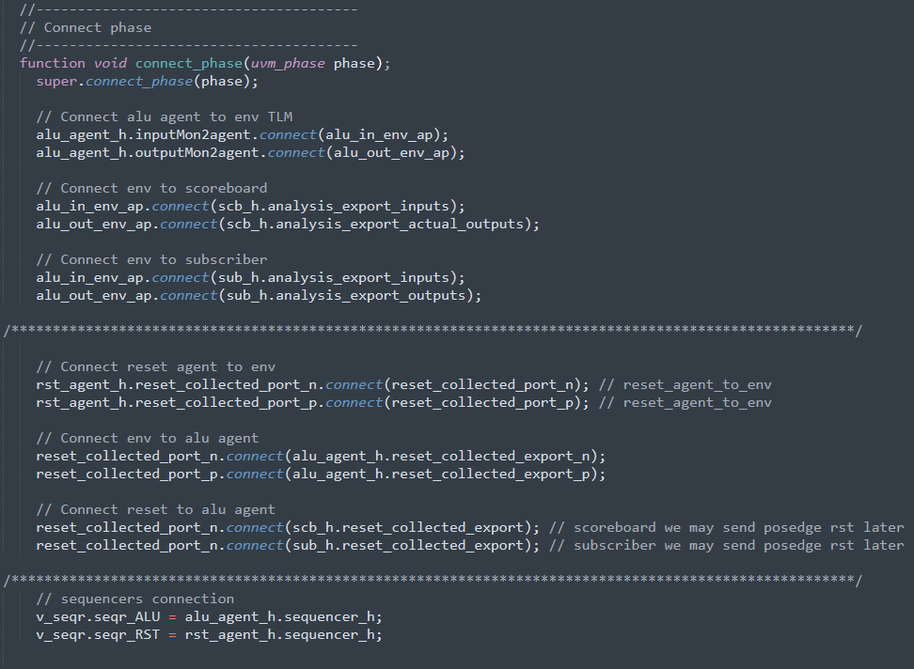
Asynchronous RST
To assert a true asynchronous reset one would need to do it through the top_testbench @random times, which is exactly what the RST Agent does, it asserts the reset @Randomized times Asynchronously by triggering an event in the RST Interface which in turn starts a reset assertion in the top_testbench.
The resets are spaced using @Reset_DELAY which is also randomized and constrained.
The reset_DURATION is also randomized and constrained.
They are both passed to the interface task and then to the top_testbench.

Slide 47
Reset Awareness
So, the driver calls the interface task, but what does the monitor do?
The monitor permanently observes the state of the reset through the virtual interface and as soon as it is asserted either high or low.
it notifies all the other components within the Environment through UVM_TLM_ANALYSIS_PORTS passing through the RST Agent, Env to UVM_TLM_ANALYSIS_EXPORTS in the the ALU Agent and its components, Subscriber & Scoreboard.
Some of these components have direct UVM_TLM_ANALYSIS_IMPS or a mix of UVM_TLM_ANALYSIS _EXPORTS & UVM_TLM_ANALYSIS_FIFOS

Slide 48
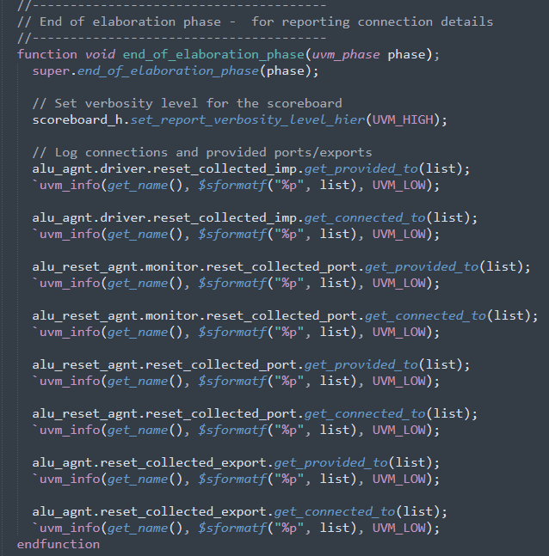
TLM debugging & Tracing
The get provided to & get connected to functions help debugging the tlm of your uvm hierarchy if there is ever an issue with it.
It gets passed a property of type uvm_port_list which I named list in this case.

Slide 49
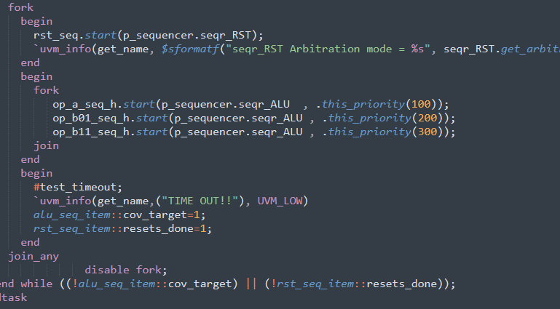
Virtual Sequence Structure
If a reset is asserted, all the reset aware components get disabled and restart their processes again, therefore a forever loop is used in the sequences, and a do-while loop is used in the virtual sequences(in the repititon_v_seq).
Both sequences (RST & repititon sequence) need to be running together not to ruin the driver/sequencer handshake, therefore causing errors.
If the reset sequence finishes, it doesn’t affect the other alu_sequence since they have stop_sequences() called within their sequencers.
On the other hand, if the roles were reversed, the reset_sequencer would generate errors due to wait for grant task being terminated without an ack

Slide 50
Virtual Sequence Structure
A timeout is added to ensure the test doesn’t hang if the coverage target isn’t hit.
The timeout is set by the top testbench and is transferred to the environment using the test_config through the base_test.
Sequence Arbitiration is added for practice, in this mode, the sequence with the highest priority inside the fork_join gets started first
The base of the Virtual Sequence (base_v_seq) is used to instantiate the sequencers, declare the p_sequencer
Each v_seq is responsible for starting the sequences using the p_sequencer

Slide 51
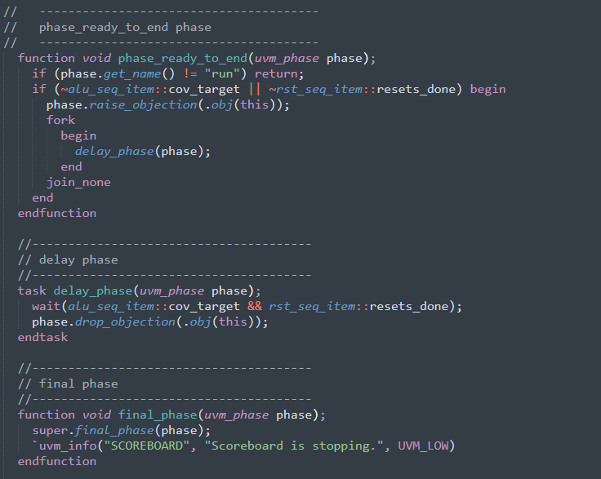
Test Termination This Test termination technique is mentioned in Clifford cummings’ OVM & UVM Techniques for Terminating Tests
The phase ready to end checks if the run phase is still running, then checks for the test’s termination flag.
(alu_seq_item::cov_target) which is asserted only when respective coverage for the respective test reaches 100%.
(rst_seq_item::resets_done) which is only asserted when the specified number of resets which were defined through the test_config file are finished.
Used the Final Phase for the scoreboard to determine when the scoreboard was shutting down to make sure no items are slipping through the test without being compared properly.

Slide 52
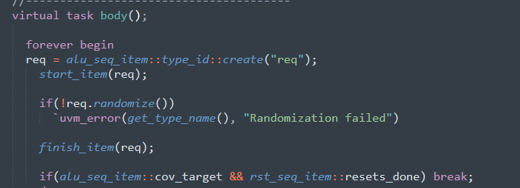
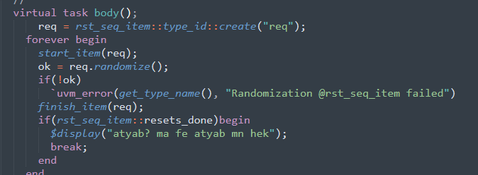
Ensuring Coverage target is hit
Both reset sequence & random the other sequence which is running alongside it is in a forever loop waiting to hit 100% coverage or to hit test timeout
Breaking from the body task only when the number of specified resets is done, and the cov_target is done.

Slide 53
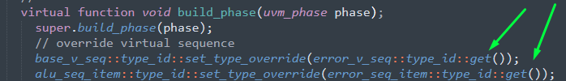
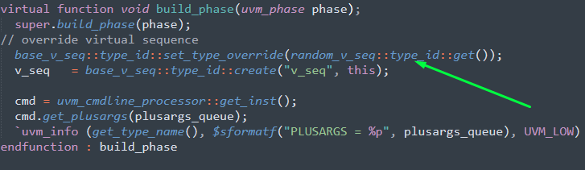

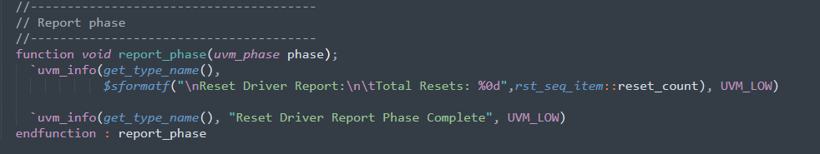
Type Overrides
Changing verbosity level of a certain part in the hierarchy
Utilizing report phase to report after the conclusion of the test

Slide 54
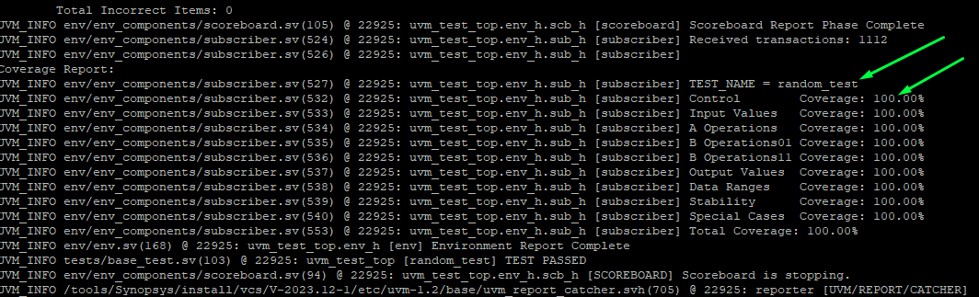
Random Test coverage target hit

Slide 55
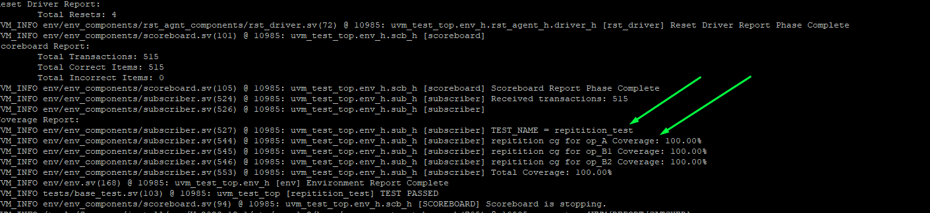
Repetition Test Coverage target hit

Slide 56

Assertions

Slide 57
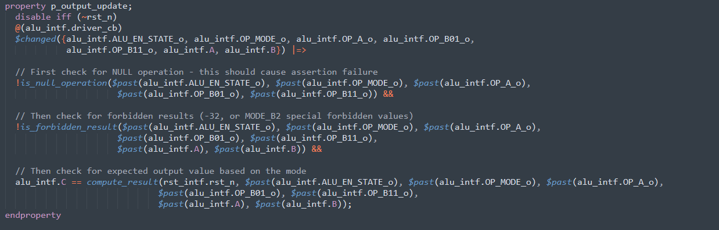
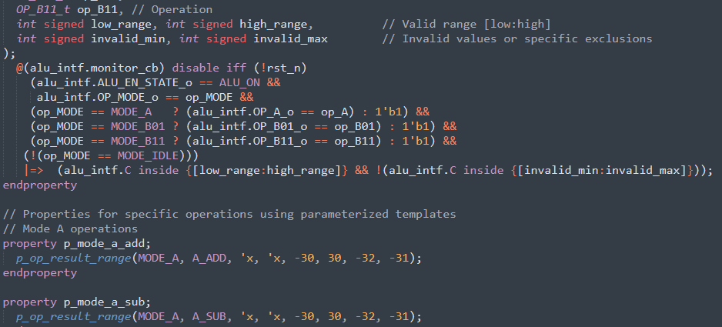
Assertions
Asserting over every possible scenario, even the error ones, providing CEXs to see them being triggered during the error_test run
Asserting over each property with an $error if the property fails
Covering each property

Slide 58
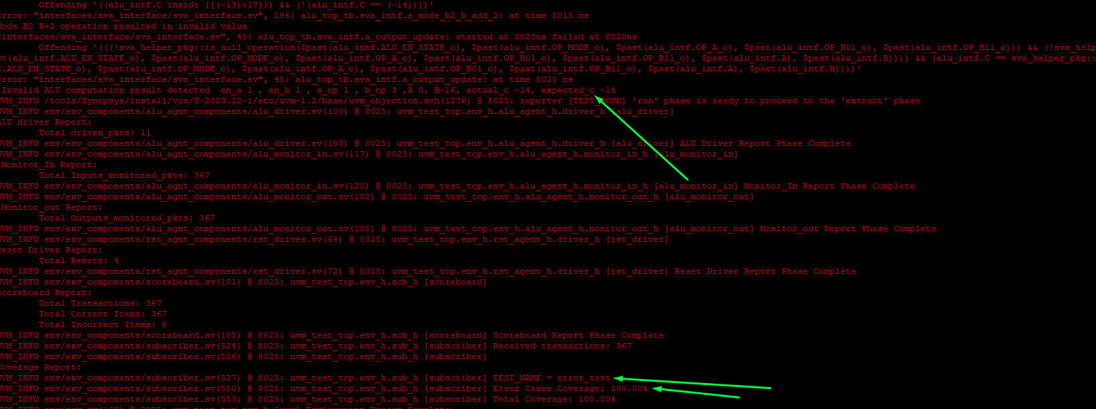
Error Test CEX assertions firing

Slide 59
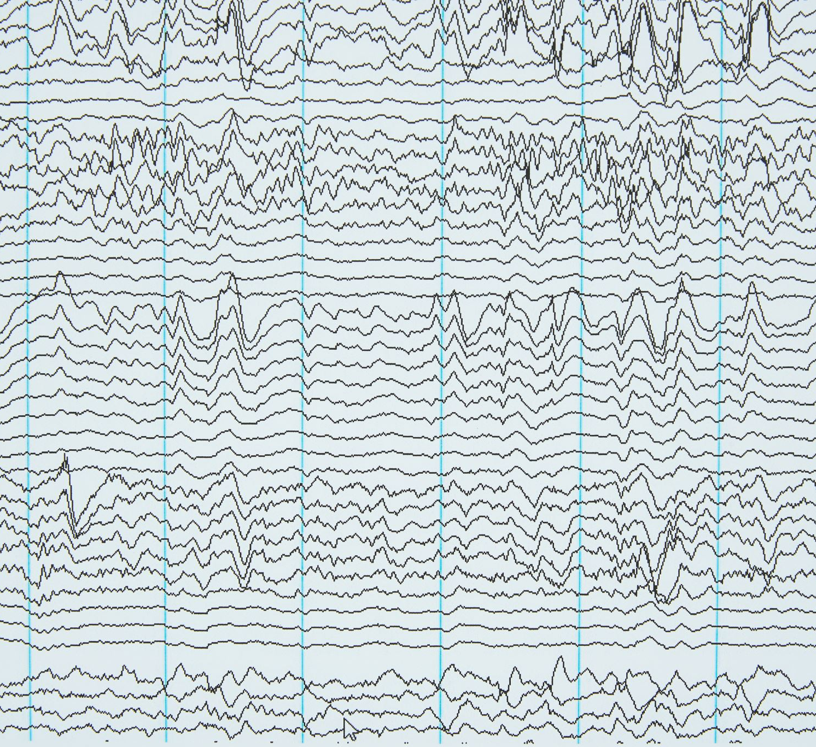
Waveforms

Slide 60
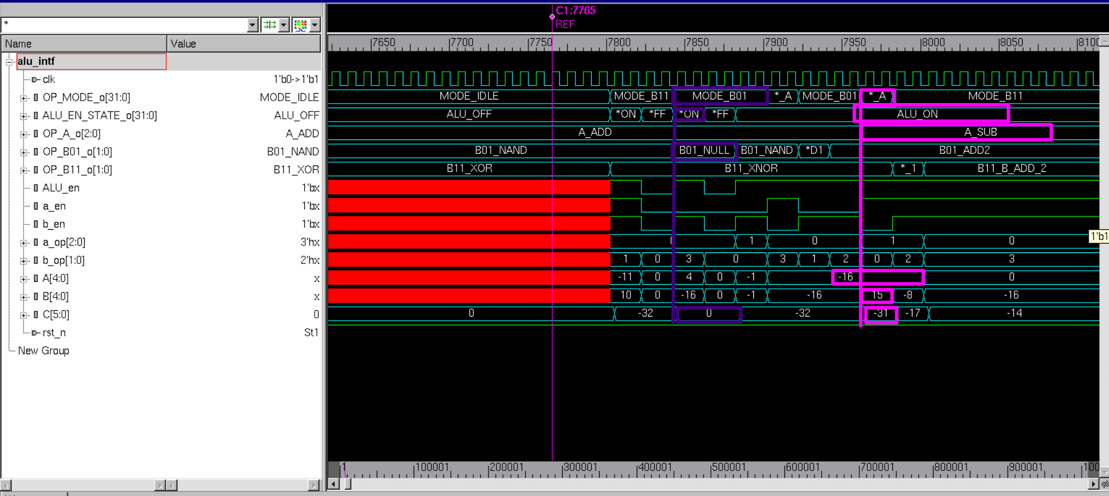
Error Test Waveform

Slide 61
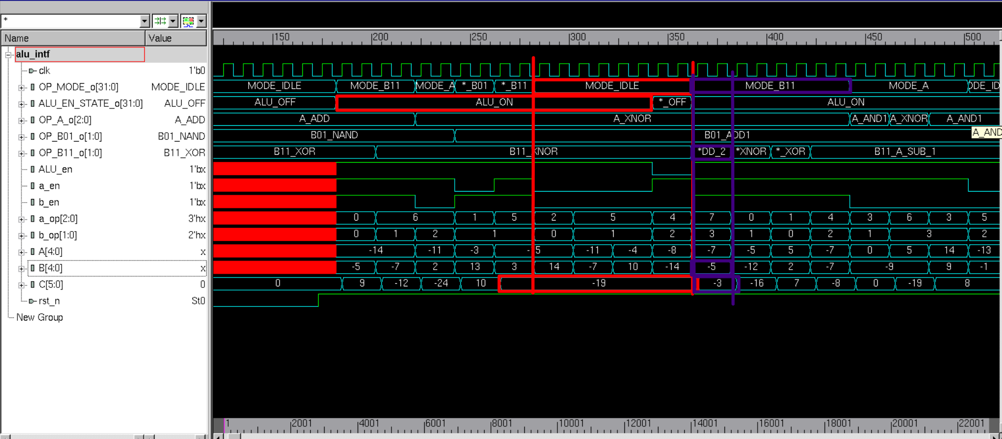
Random Test Waveform

Slide 62
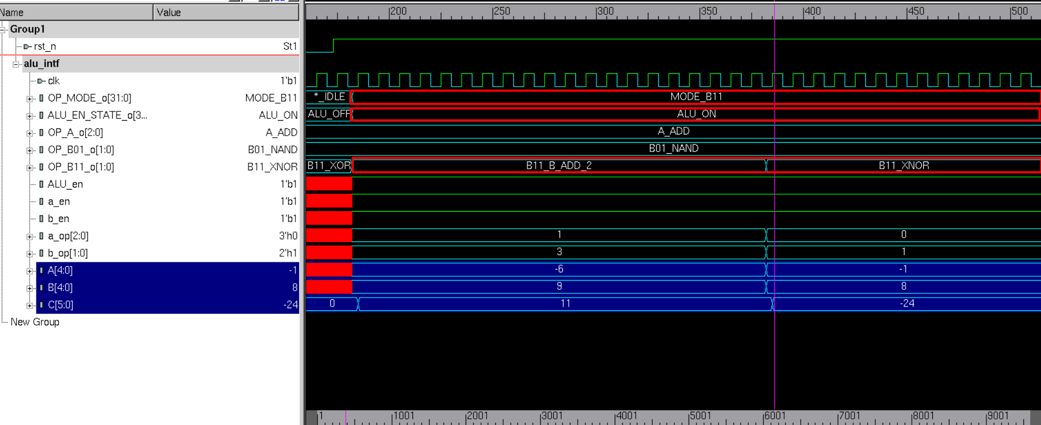
Repetition Test Waveform

Slide 63

Verbosity

Slide 64
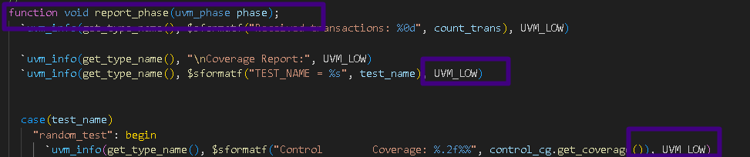
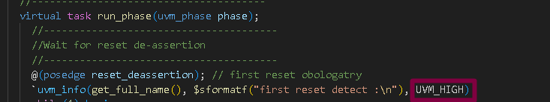
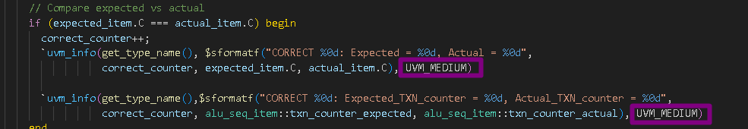
Different Verbosity for Different Debugging Needs
UVM_LOW for Reporting & Checking that the hierarchy is starting correctly & Scoreboard Mismatches
UVM_HIGH for deep-level & case Debugging (usually during the development phase)
UVM_MEDIUM for Correct Cases tracing & Expected behaviour

Slide 65
COVERAGE? What? For What?

Slide 66
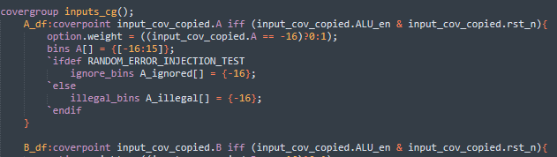
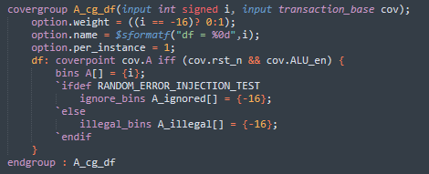

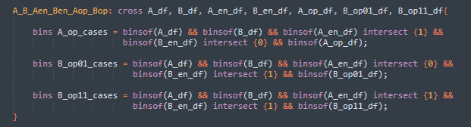
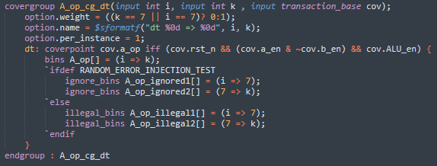


Coverage Examples
Fixed/Cross – based coverage
method
Instance – based coverage method
BODY
Construction
Sampling

Slide 67

Coverage Closure

Slide 68
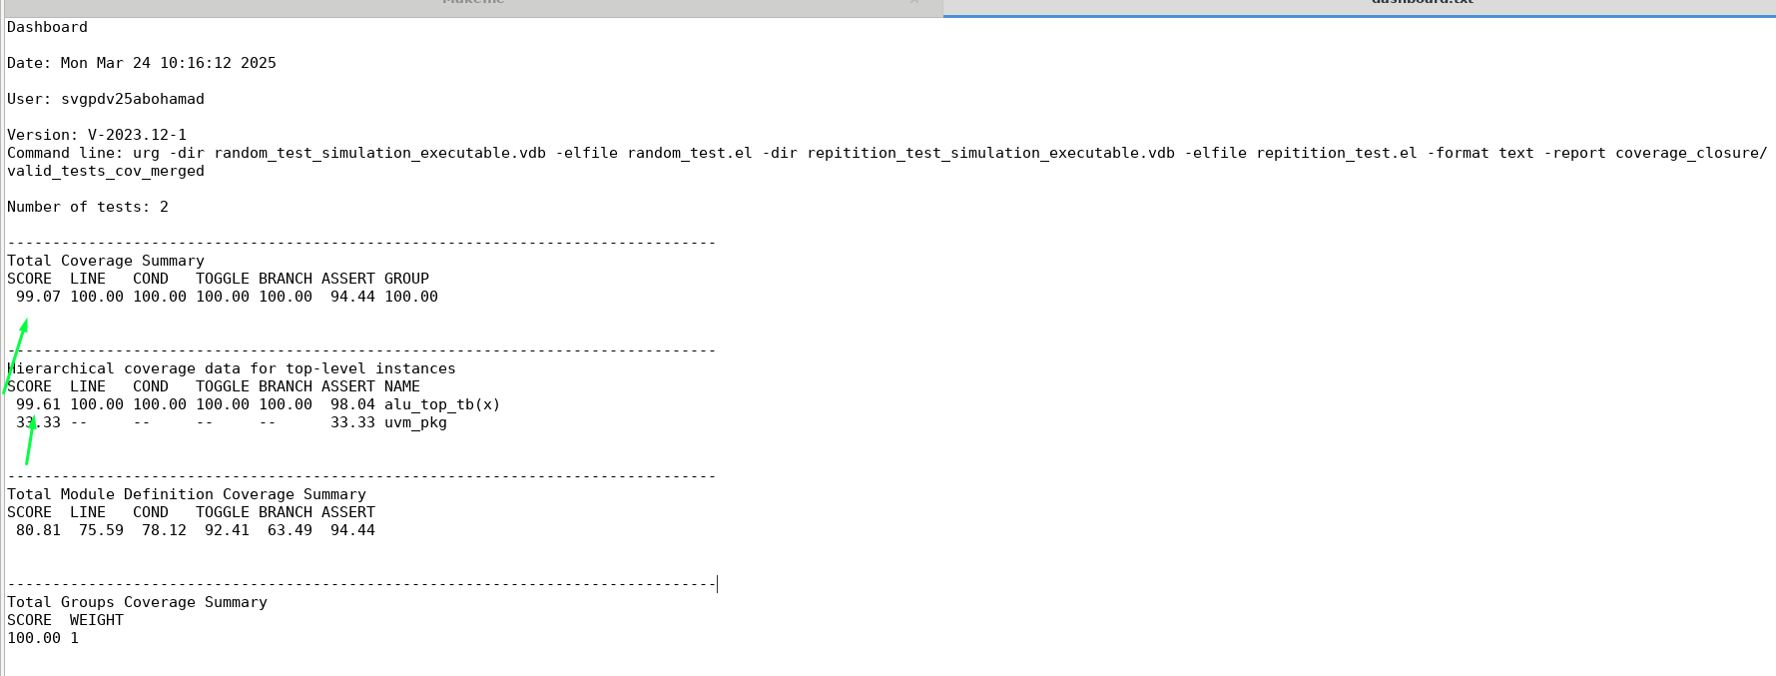
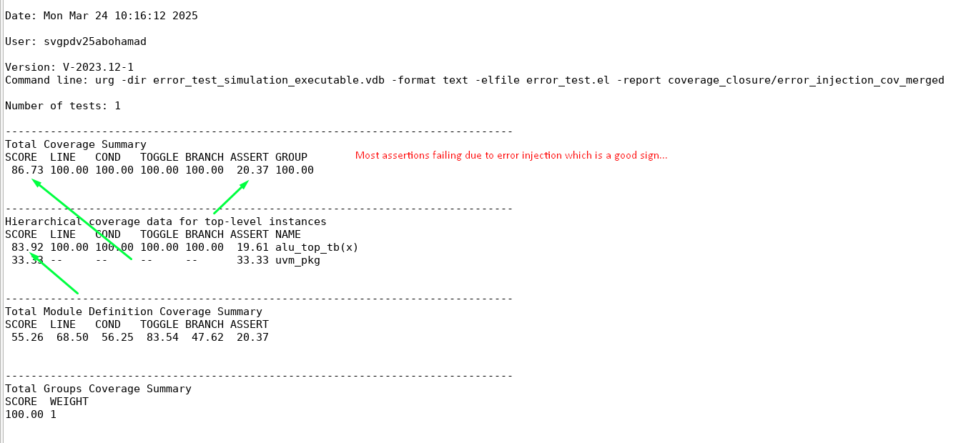
Dashboard.txt for valid Test
Dashboard.txt for Error Injection Test

Slide 69
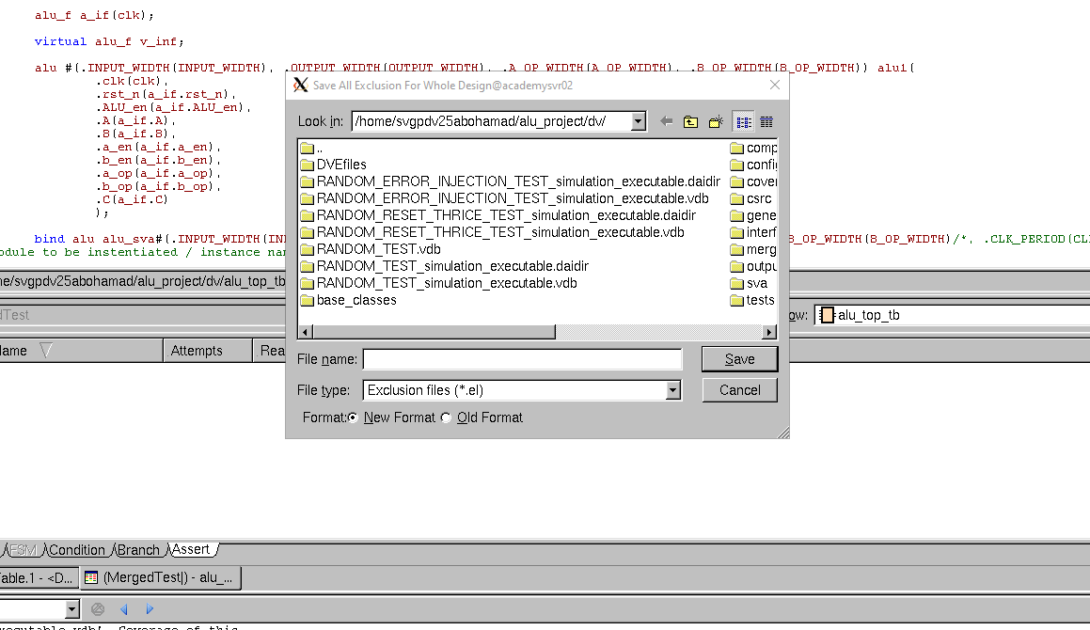
Exclusions and .el files
Exclusions can be done in the merge command line using –exclude but the naming of the branches, points, ..etc is often hard to make out and understand to just do it from the line, therefore using dve to make the .el file is much easier and thereafter including them in the report command.

Slide 70
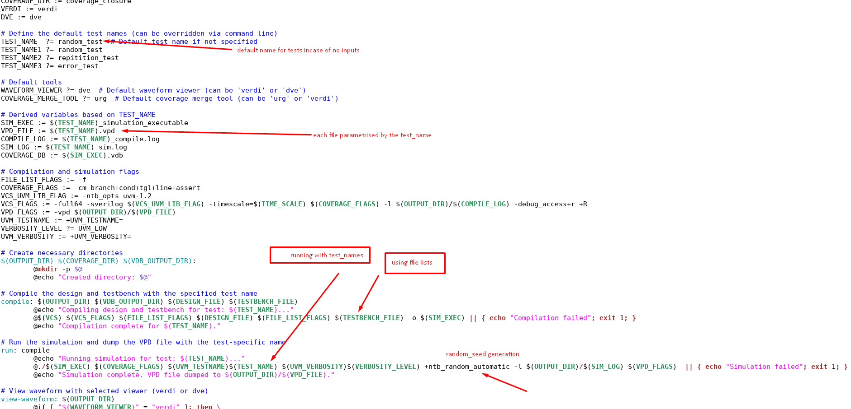
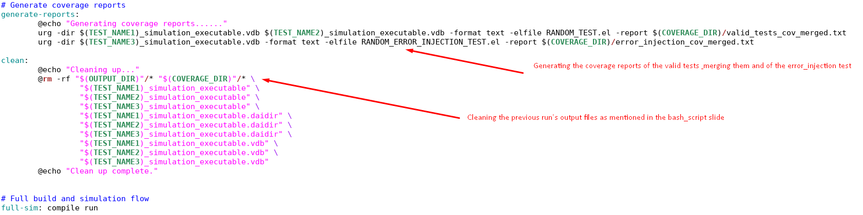
Scripting & Makefiles
Makefile to compile, run, check the simulation waveform using the .vdp files & clean each time the clean task is called or when the run_all.sh is executed
Saving compile and simulation.log files so they can be searched for any errors using a script if I have the time to make one
Choosing between Verdi & DVE for wave viewing Choosing between urg and Verdi for vdb merging USE make help to understand the tasks

Slide 71
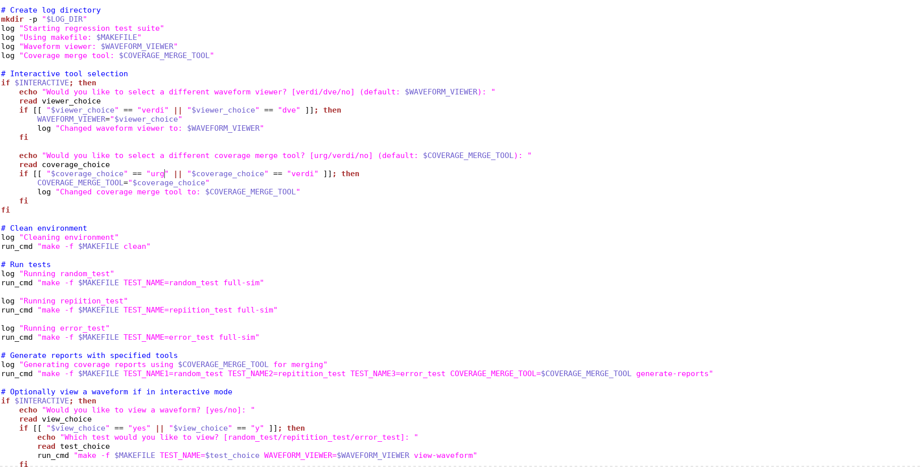
Scripting & Makefiles
Bash script that runs regression using the Makefile tasks

